Slide 1
Book Heraldry 100
Introduction
Presented by
Yehuda ben Moshe
Elmet Herald
Notes:
If you don’t know what “Elmet Herald” means, you will by the end of the class.

Slide 2
Introduction
What do SCA Heralds do?
  Book Heraldry
    Names
    Armory
  Voice Heraldry
    Court
    Tournament
    Silent
  Other
    Order of Precedence
    Regalia
Notes:
Armory is a broader term incorporating devices and badges
Silent heraldry activity varies by kingdom – not much in East, more common elsewhere (Middle? Aethelmearc?)

Slide 3
Introduction
EK Herald University classes:
  Book Heraldry 100 – this class
  Book Heraldry 101 – paperwork
  Court 100 – Court chancery for the baronial herald
Notes:
Not all classes are available yet, they are being worked on
I will teach some, other instructors will teach others
Most will be available online, and taught at select events
Some, such as those focusing on voice, will be in-person only

Slide 4
Introduction
EK Herald University classes:
  Armory 101 – Intro to armory
  Armory 102 – Charge group theory and style rules
  Armory 103 – Conflict rules and basic conflict checking
  Armory 201 – Advanced conflict checking using the complex search form
  Armory 201 – Individually Attested Patterns

Slide 5
Introduction
EK Herald University classes:
  Names 101 – Intro to name

Slide 6
Organization of the College
Society Level (“Laurel” level)
  Known as the “College of Arms” (CoA)
  Laurel Sovereign of Arms
    Chief heraldic officer of the SCA
    Currently (Sep 2013) Meistari Gabriel Kjotvason
Notes:
Laurel has two main deputies – Pelican and Wreath

Slide 7
Organization of the College
Society Level (“Laurel” level)
  Pelican Sovereign of Arms
    Handles names submissions
    Currently (Sep 2013) Dame Juliana de Luna
  Wreath Sovereign of Arms
    Handles armory submissions
    Currently (Sep 2013) Magistra Emma de Fetherstan
Notes:
Wreath/Pelican not set in stone – been broken up other ways before

Slide 8
Organization of the College
Society Level (“Laurel” level)
  Several other officers:
    http://heraldry.sca.org/jobs.html
    Clarion – education
    Palimpset – rules
    Morsulus – O & A
    Ragged Staff – file clerk
    Codex – web minister

Slide 9
Organization of the College
Kingdom Level
Known as College of Heralds (CoH)
  Kingdom Principal Herald
    Head herald for Kingdom
    Brigantia Principal Herald in the East
  Internal and/or External Submissions Heralds
    Handle name and armory submissions
  Other staff heralds vary by Kingdom
Local branch heralds and Heralds-at-large
Notes:
In the East, Brignatial Principal Herald is currently Master Ryan MacWhyte; Eastern Crown Herald (internal submissions) is Mistress Alys Mackintoich, and Blue Tyger Herald (external submissions) is Lord Joscelin le esqurel

Slide 10
Organization of the College
Herald Ranks
  Pursuivant
  Herald
  Herald Extraordinary
  Sovereign-of-Arms
  Other
    Macer
    Cornet
    Pursuivant Extraordinary

Slide 11
Organization of the College
Herald Ranks
  Usage varies by Kingdom
  In some Kingdoms, ranks are awarded to individuals as they advance
    Atlantia
  In other Kingdoms, ranks are linked to specific offices
    East
Notes:
In the East, kingdom staff heralds are Heralds, local heralds are pursuivants, but the title stays with the office.

Slide 12
Organization of the College
Herald Ranks
  Sovereign-of-Arms
    Reserved for Laurel and two deputies – Wreath and Pelican
  Herald Extraordinary
    Awarded by Laurel or by a Kingdom Principal Herald
    Awarded for significant service to the College of Arms
    Allows the registration and use of a Personal Heraldic Title

Slide 13
Organization of the College
Heraldic Titles
  Titles must be registered with the College of Arms as a Non-Personal Name
  Personal titles are registered by the individual
  Titles associated with offices are registered by the branch

Slide 14
Organization of the College
Forms of Address
  It is appropriate to address a heraldic title holder by given name + title
  Examples:
    Meistari Gabriel Kjotvason can be called “Gabriel Laurel”
    Master Ryan MacWhyte can be called “Ryan Brigantia”
    I can be addressed as “Yehuda Elmet”
  Generally not combined with other honorifics
Notes:
So we wouldn’t say “Master Ryan Brigantia” or “Lord Yehda Elmet”

Slide 15
Organization of the College
Forms of Address
  Informally, can address by title alone
  Often used in commentary and herald-oriented email
  Examples
    Laurel
    Brigantia
    Elmet

Slide 16
Becoming a Herald
Many kingdoms warrant heralds
  Usually connected to handling money
  Not required in the East
Periodic reports
  Kingdom-dependent
Group Herald vs. Herald-at-Large
OSCAR access
  Must be authorized by Kingdom Principal Herald
Notes:
In the East, periodic reports only required for group heralds at the moment

Slide 17
Websites
SCA College of Arms
  http://heraldry.sca.org/
  Rules
  Articles
  Letters of Acceptance and Return archive
  Contact information
Notes:
This is the main website to know, you will use it very often

Slide 18
Websites
Kingdom College of Heralds websites
Kingdom submission websites
  Forms and instructions for submitting names and armory
  Each kingdom has one:
    http://ech.eastkingdom.org/ - East
    http://www.aeheralds.net/ - Æthelmearc
    http://www.midrealm.org/heraldry/escutcheon/ - Middle
Notes:
For us as book heralds, the submission website is key.

Slide 19
Websites
Academy of Saint Gabriel
  http://www.s-gabriel.org/
  Not an official SCA website
  Medieval Name Archive – articles on medieval names
  Medieval Heraldry Archive – articles on medieval armory and links to period armorials
  Academy Reports – answers to specific questions
    Not accepting new questions at this time
Notes:
Origin of the Academy is a bunch of very knowledgeable SCA heralds who would accept questions about specific names and devices. They don’t really do that anymore, but there are still articles published.

Slide 20
Mailing Lists
https://lists.andrew.cmu.edu/mailman/listinfo/sca-hrlds - SCA-HRLDS mailing list
Kingdom Lists
  Many are listed at http://heraldry.sca.org/kingdoms.html
  ekheralds-subscribe@eastkingdom.org – East Kingdom heraldry mailing list, send blank email to subscribe
Notes:
SCA-HRLDS - good place to go with complex technical question, all the SCA senior heralds are on it.
Definitely join your kingdom one as well.

Slide 21
Mailing Lists
Kingdom Education Lists
  East Kingdom: EKHerEd-subscribe@yahoogroups.com – East Kingdom heraldry education mailing list, send blank email to subscribe
Facebook group: SCA Heraldry Chat
Google+ community: SCA Heraldry
Notes:
EK Her Ed is a must for EK heralds – great place to ask newbie questions
The FB group is a good place to hang out and learn – very active

Slide 22
Rules
SENA
  Standards for Evaluation of Names and Armory
  Found at: http://heraldry.sca.org/laurel/sena.html
  Current rules for all submissions
  Broken into 4 main sections:
    General Principles
    Personal Names
    Non-Personal Names
    Armory
  Also includes 13 appendices
Notes:
If you know the old RfS, things have changed
If you don’t know, even better – less to unlearn
Non-Personal Names are names of SCA branches, households, award orders, and heraldic titles

Slide 23
Rules
GP1A: "Laurel shall define standards suitable to the type of item to be registered, and apply them uniformly to all such submissions. These standards shall be designed to support the historical re-creations of the Society and to provide sufficient difference from names and armory registered within the Society to avoid undue confusion, to avoid the appearance of unearned honors or false claims, and to provide sufficient difference from historical or fictional personages to prevent offense due to obvious usurpation of identity or armory. Members are encouraged to develop unique, historically valid names and armory."
Notes:
First letter of the rule number is GP for General Principle, A for Armory, PN for persona names, and NPN for non-personal names
Avoiding conflict is mandated by corpora, even though names in period weren’t conflict checked
Whether you like that or not, only the BoD can change that

Slide 24
Rules
GP1B1: Submissions should be reasonably period
  Period elements
  Period combinations of the elements
  “Core style” defines most common elements and combinations
  Individually attested patterns allow submissions outside core style
Notes:
Letter and numbers are alternated in the rule numbers.
No “Moonunit” in names and no molecules in armory
Period Combination – example: Siebermacher and Hoffmaister
IAP examples – black lion on red field

Slide 25
Rules
GP1B2: Submissions should be free of conflict, presumption, or offense
  Conflict prohibits submissions that are too close to another SCA registration
    Permission can be given to resolve a conflict
  Presumption prohibits submissions that are too close to an important non-SCA person, or which claim special powers or position
    Permission cannot resolve a presumption problem
  Offense prohibits submissions that are offensive to the populace or general public.
Notes:
None of these have anything to do with being period – these are modern SCA requirements
“John Smith” vs “Johnny Smith” can be resolved with permission
“Harry Potter” or “Johnny Cash” are presumptuous, permission won’t fix it
Examples of offense – swastika, testicles (sometimes subjective call)

Slide 26
Rules
GP3A: Definition of Period - Time
  Generally before 1600
  The period 1600-1650 is known as the “grey period”
    Elements will usually be allowed
  No official beginning time, but must be from cultures known to Medieval and Renaissance Europe
    Classical Greek and Roman elements are acceptable
    Elements from Pharaonic Egypt are not acceptable
Notes:
Gray Period is based on the idea that something found in that time probably existed earlier
Exception to Gray Period include elements we know were not known/created until after 1600 such as some Shakespearean names and Australian fauna.

Slide 27
Rules
GP3B: Definition of Period – Place
  Any part of Europe is always allowed
  Names
    Names from other cultures that had contact with period Europe are allowed for people and households
    Not allowed for SCA Branches
  Armory
    Non-European heraldic elements and patterns are allowed
    Rules are stricter than for European
Notes:
Europe generally goes as far east as Russia, as far South as Greece, Italy, and Spain, but probably does not include Muslim Spain, nor the Middle East

Slide 28
Rules
GP4 – Definitions
  Attested
  Constructed
  Precedent
  Documentation
  Step from Period Practice
    “Weirdness”
    No longer used for names
Notes:
Constructed: “Robertson” + “John” gets us “Johnson” as a constructed name
Primary vs. Secondary documentation
Reputable source – published for academia, by one of the common SCA sites
Don’t use Wikipeda – but Wikipedia sources may be ok
SFPP example – compass star
Allowed one SFPP, but not more

Slide 29
Rules
Administrative Handbook (AH)
  http://heraldry.sca.org/laurel/admin.html
  Covers submission procedures
  Includes non-submission actions
    Reconsiderations
    Appeals
    Heraldic Wills
  Duties of senior Heralds
  Appendices
Notes:
Reconsideration – name changed from that submitted, and would like it changed back, or changed to a recommended version
Appeal – name or device returned, requesting it be approved

Slide 30
Rules
Administrative Handbook (AH)
  Appendices
    Appendix D – standard form letters
      Permission to conflict
      Heraldic will
      Transfers
      Petitions
      Releases
    Appendix F – Name sources to avoid
    Appendix H – Sources that don’t require photocopies
Notes:
Don’t use Appendix H as a shopping list – these are commonly available sources, not necessarily good ones.

Slide 31
Rules
Glossary of Terms (GT)
  http://heraldry.sca.org/coagloss.html
  Defines many terms
  Includes several tables:
    Regalia
    Reserved and Restricted charges
    Standard tinctures and postures
  Lists oft-misused terms

Slide 32
Submission Process
Consultation
  The process of a herald helping a client choose and document a name or device submission
  Not required in all kingdoms
  In some kingdoms, the consulting herald takes the forms and payment and forwards them to the Kingdom Submissions Herald
  In other kingdoms (East) the client mails forms and payment themselves

Slide 33
Submission Process
Internal Letter of Intent (iLoI)
  In some Kingdoms called Letter of Presentation (LoP)
  Collects a number of submissions for in-kingdom commentary
  Issued by a senior kingdom herald (Eastern Crown Herald in the East)
  At least two Kingdoms don’t use iLoIs.
Notes:
Typically monthly

Slide 34
Submission Process
Internal Commentary
  A period during which heralds from within the Kingdom can comment on submissions
  Excellent learning opportunity
    Newer heralds are highly encouraged to comment and ask questions
  Duration varies – usually one month in the East
  Names and device emblazons can be updated if a problem is found
  Not used in all Kingdoms

Slide 35
Submission Process
Decision Meetings
  Only used in some Kingdoms
  A senior kingdom herald (Eastern Crown Herald in the East) makes decisions as to which submissions have significant problems
  In some kingdoms (AEthelmearc, Meridies) these are held over video conference and are open to the public – excellent learning opportunity

Slide 36
Submission Process
Kingdom Letter of Decision
  A senior kingdom herald (Eastern Crown Herald in the East) publishes the results of the kingdom commentary and/or decision meetings
  Those without problems are forwarded to Laurel
  Those with problems are returned for further work

Slide 37
Submission Process
External Letter of Intent (xLoI)
  Similar to the iLoI, this letter will include those submissions forwarded by Kingdom to Laurel
  Issued by a senior kingdom herald (Blue Tyger Herald in the East)

Slide 38
Submission Process
External Commentary
  A period during which heralds from the entire SCA can comment on submissions
  Generally commentary is done by more senior heralds - new heralds are encouraged to read commentary, but probably should not comment unless they have special knowledge
  Duration is two months
  Names can be changed, but device emblazons cannot

Slide 39
Submission Process
Decision Meetings
  Based on external commentary, Society-level senior heralds make final decisions as to the registration of each submission
  Pelican Queen-of-Arms rules on names
  Wreath Queen-of-Arms rules on armory
  Generally done at a meeting where other senior heralds participate, in person and by text chat

Slide 40
Submission Process
Proofreading
  Once the decisions are made and written up, they go out for two rounds of proofreading
  Generally takes about one month
  Proofreaders are sworn to secrecy – please don’t ask them for previews…

Slide 41
Submission Process
Letter of Acceptances and Returns (LoAR)
  Official publication of the registration decision
  Sent out once per month by email and posted at http://heraldry.sca.org/loar/

Slide 42
Submission Process
Letter of Acceptances and Returns (LoAR)
  Organized into
    Acceptances
    Returns
    Pends (delays) – usually to allow more commentary
  Further subdivided by kingdom of submission
  Cover Letter
    Organizational info
    Important rulings and other information

Slide 43
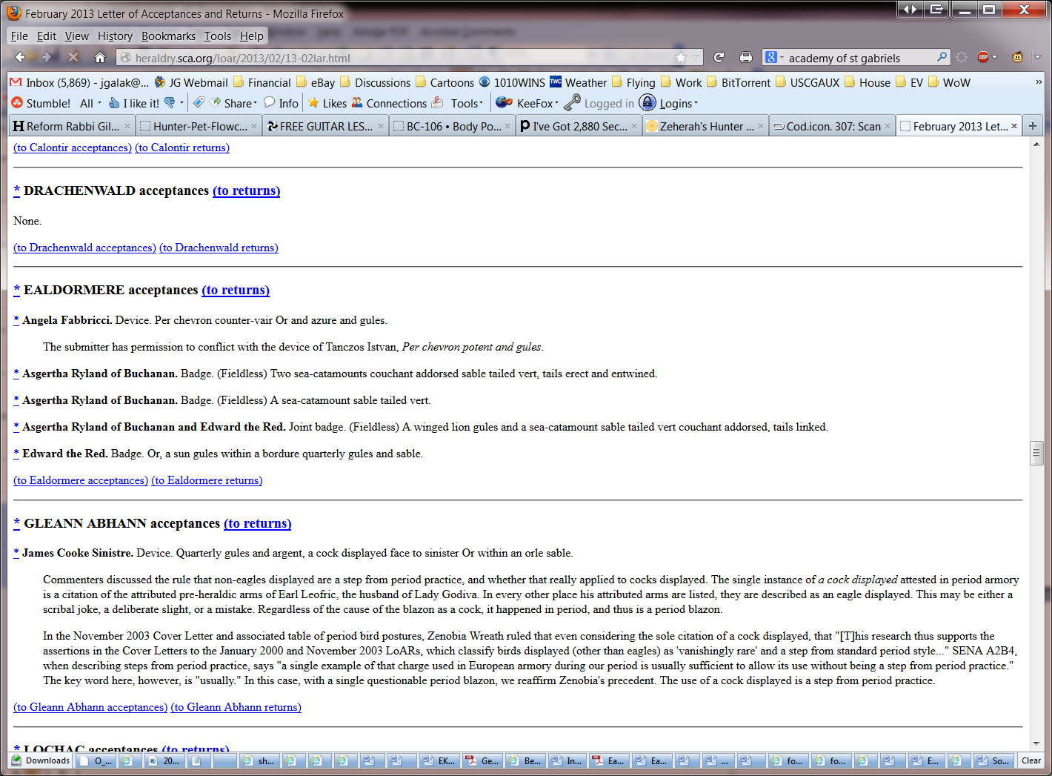
Submission Process
Letter of Acceptances and Returns (LoAR)

Slide 44
OSCAR
Online System for Commentary and Response
http://oscar.sca.org
All LoIs and commentary are handled through OSCAR.
Main part contains xLoIs and Laurel-level commentary
Kingdom “Gardens” contain iLoIs and Kingdom-level commentary

Slide 45
OSCAR
Public access
  Freely open to anyone, not just heralds
  Allows viewing of all xLoIs and some iLoIs
  Generally does not allow viewing of commentary
  Useful for checking on submission status
    Tell your clients to click on “Sub Status”
    Only works once submission has made it to an xLoI

Slide 46
OSCAR
Creating an account
  Step 1: Click on “Create Account” and fill out the form
  Step 2: Contact your kingdom’s principal herald to have your account activated for commenting
    May require warranting in some kingdoms
Notes:
In the East, Ryan Brigantia usually approves everyone very quickly.

Slide 47
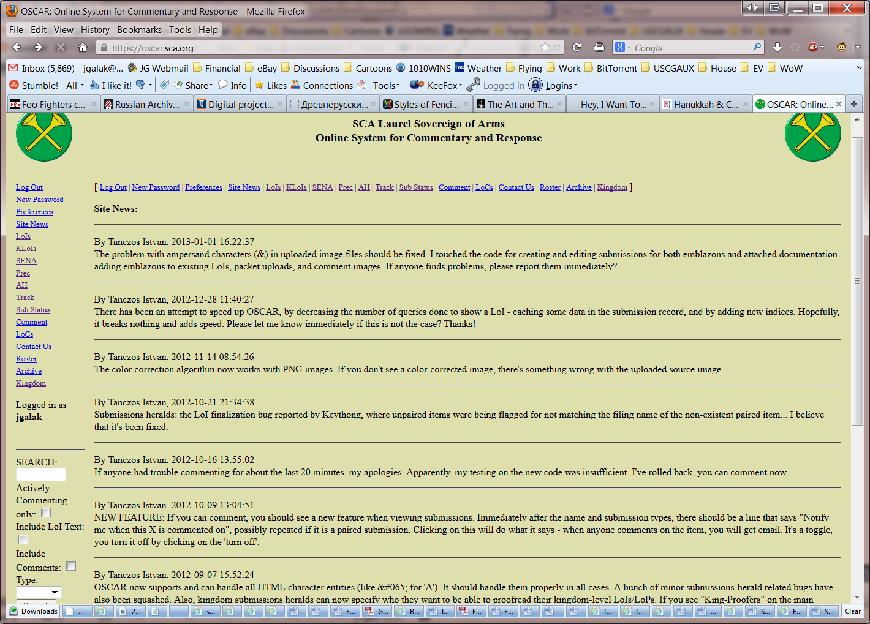
OSCAR
Main Page

Slide 48
OSCAR
Navigation
SENA – shortcut to SENA
AH – shortcut to the Administrative Handbook
Track – table of all recent xLoIs
Sub Status – useful for tracking a submission
Kingdom – link to the Kingdom Gardens

Slide 49
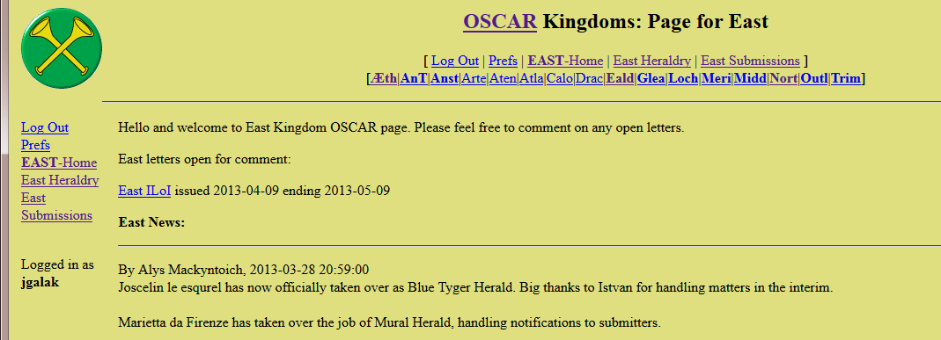
OSCAR
Kingdom Gardens
  Kingdom iLoIs
  Links to other Kingdoms
  Kingdom-specific posts

Slide 50
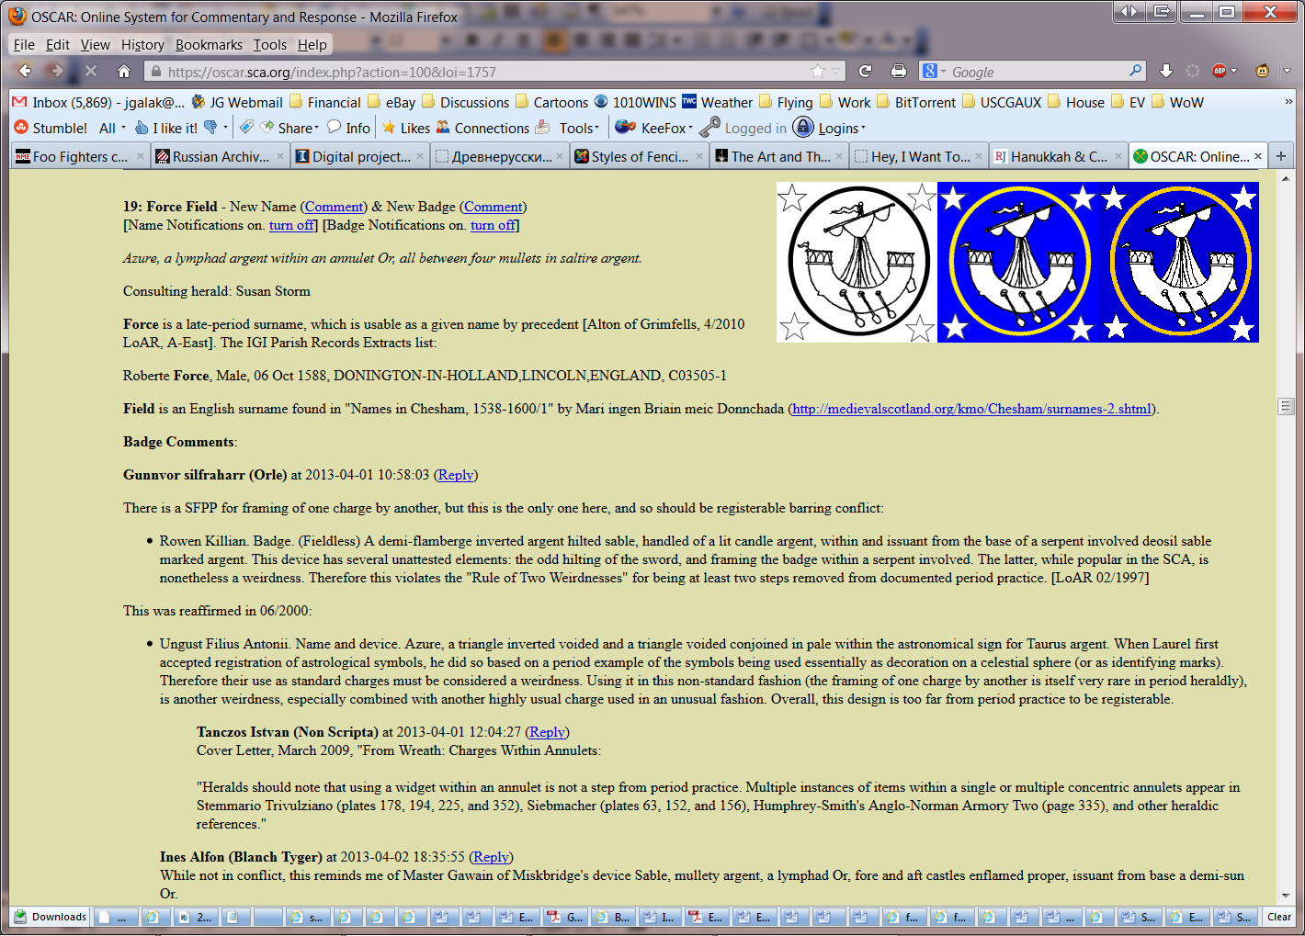
OSCAR
LoI
Notes:
April 1 LoI

Slide 51
OSCAR
LoI - Header
  Notification toggles
  Blazon
  B&W, color, and color-corrected emblazon
  Documentation
Notes:
Color-corrected emblazon helps with scanner issues, coloration issues

Slide 52
OSCAR
LoI – Commenting
  Threaded commenting

Slide 53
OSCAR
Privileges
  Set by Kingdom Principal Heralds
  May include
    Viewing and commenting on your Kingdom’s iLoIs
    Viewing and commenting on other Kingdoms’ iLoIs
    Viewing and commenting on Laurel-level xLoIs

Slide 54
Precedent
Precedent is set on LoARs
Rulings on registrations can create precedent
Precedent can also be set on a LoAR Cover Letter
Items registered without comment do not create precedent
  “Prior registration is not a guarantee of future registration”

Slide 55
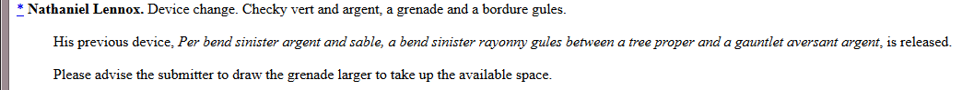
Precedent
Not precedent:
  Simply a note on a registration
  Artists note

Slide 56
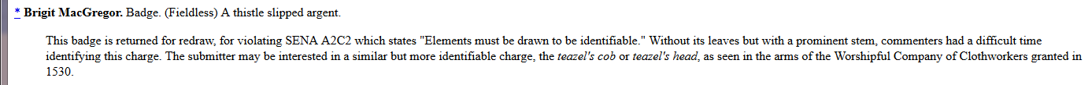
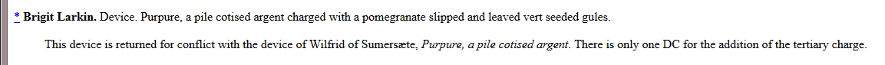
Precedent
Not precedent:
  Reason for return is unique to this submission
  Identifies a conflict

Slide 57
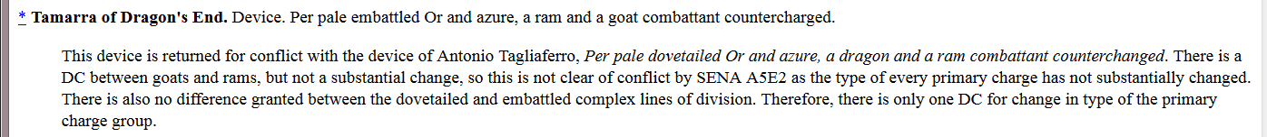
Precedent
Precedent:
  Ruling establishes (or reiterates) specific rules
Notes:
Three different precedents: 1) DC Between goat and ram 2) No SC between a goat and ram 3) No DC between dovetailed and embattled complex line of division

Slide 58
Precedent
“Standard” citation format:
  [Angela Fabbricci, A-Ealdormere, Feb 2013 LoAR]
  [Brigit Larkin, R-Ealdormere, Feb 2013 LoAR]
  [Cover Letter, Feb 2013 LoAR]
Notes:
Important to include all three elements in a cite

Slide 59
Precedent
Collected Precedents
  http://heraldry.sca.org/laurel/precedents.html
  Organized by Laurel Tenure
    Armor current through July 2008
    Names current through May 2005
  Compiled Name Precedents
    Current through May 2004
  Other ongoing or future projects
Notes:
Not very useful in my opinion
My project for this is linked from my site

Slide 60
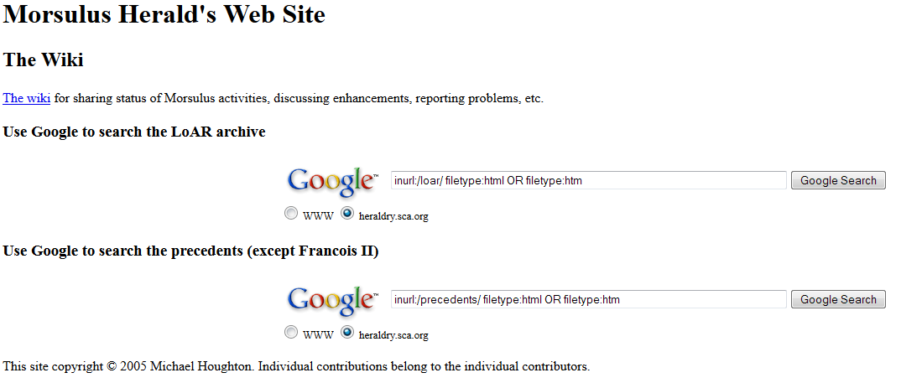
Precedent
Searching Precedents
  http://www.morsulus.org/

Slide 61
Final Thoughts
Registerable vs. Authentic
  A submission must be registerable, it need not be authentic
  While we can encourage clients to design authentic names and devices, we cannot, and should not force the decision
  If a client is set on a registerable but not very authentic submission, you should process it!

Slide 62
Final Thoughts
Customer Service
  It is our job to help our clients
  We are here to make registrations happen, not prevent them from happening
  When consulting, help clients create registerable submissions they like
  When commenting, look for reasons to allow registration, not prohibit it
  Heralds want a reputation for being helpful, not obstructionist!
Notes:
The college has a reputation for being a bunch of people who say “no”. Lets work against that rep.

Slide 63
About me
Elmet Herald – I am the East Kingdom heraldic education deputy
elmet@eastkingdom.org
jgalak@gmail.com
This handout can be found at:
  http://www.yehudaheraldry.com/

